Slide 1

MEMBERS :
Alina Melony Pinto – 191IT206
Gayathri Nisha – 191IT116
K Sakshi Thimmaiah – 191IT124
Nishka Kotian – 191IT136
TRAVELING SALESMAN PROBLEM
Implementation of algorithms
Notes:
1

Slide 2
INTRODUCTION
The Traveling Salesman Problem (TSP) is related to the real-life analogy of a salesman who has to visit a number of cities while taking the shortest possible path.
The salesman's goal is to keep both the travel costs and the distance travelled as low as possible.
Focused on optimization, TSP is often used in computer science to find the most efficient route for data to travel between various nodes.

Slide 3

ALGORITHMS IMPLEMENTED
Naïve approach
Dynamic programming
Genetic algorithm
Branch & Bound method
Notes:
3

Slide 4
WORK DONE
Naïve solution : The naïve or brute force solution aims at computing and verifying all the possible permutations and thereby choosing the minimum/shortest possible solution.
This approach has a time complexity of O(N!) which is not very efficient for large datasets.
Dynamic programming : In Dynamic Programming (DP), we build the solution as we go along. In our case, this means that our initial state will be any first node to visit, and then we expand each state by adding every possible node to make a path of size 2, and so on.
g(i,S) = min{Cik + g(k,S-{k}}
This approach has a time complexity of O(2^{n}n²).

Slide 5
WORK DONE
Genetic algorithm :
Genetic algorithms (GA) are based on the survival of the fittest chromosome among the species which are generated by random changes in their gene-structure in evolutionary biology. The possible model behaviours are encoded into genes (here, cities are taken as genes). The proposed algorithm is motivated by the observation that genes common to all the individuals of a GA have a high probability of surviving evolution and ending up being part of the final solution; as such, they can be saved away to eliminate the redundant computations at the later generations of a GA.

Slide 6
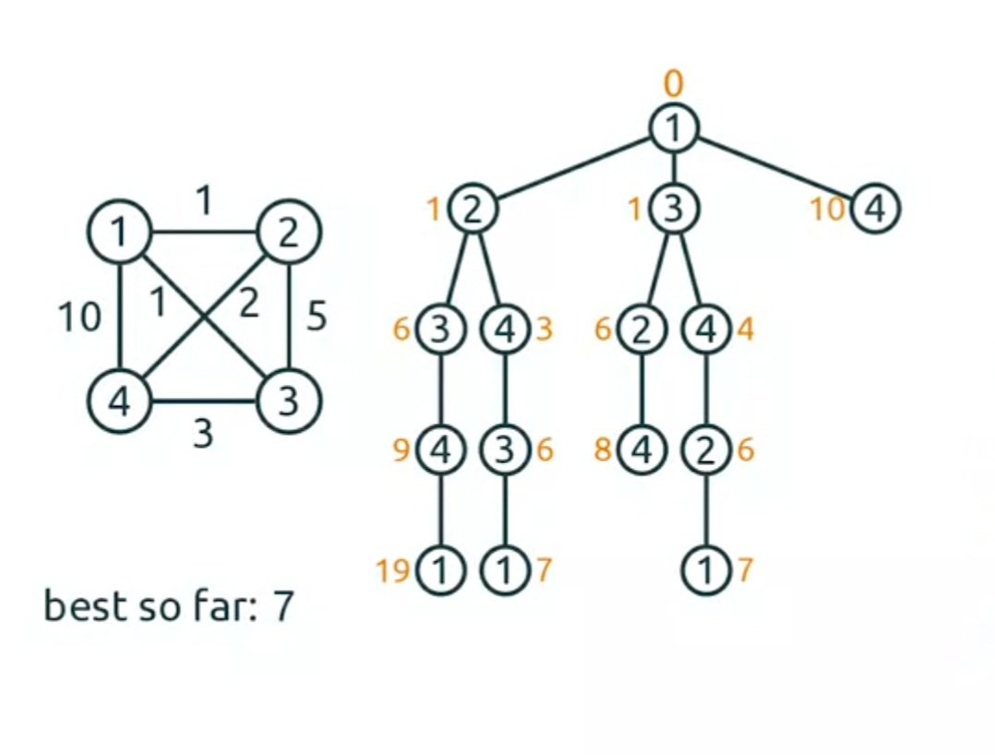
WORK DONE
Branch and bound :
This method based on the idea that the sets are divided into
2 disjoint subsets at every step of the process – branching.
Furthermore, one subset contains the path between the two
selected towns and the other subset does not. For each of
these subsets, the lower restriction (bound) is calculated
for the duration or for travel expenses. Finally, the subset
which exceeds the estimated lower bound is eliminated.

Slide 7
RESULTS
Naïve approach : The time complexity is O(n!) due to which it is not suitable for real-world applications. This approach always gives the exact solution but comes at the cost of huge runtimes.
Dynamic programming : The shorest optimal path is obtained by this approach. Its time complexity is O(2^n.n²) as the problem is divided into atmost 2^n.n recursive subproblems of linear time.
Branch & bound method : This technique is also an exact algorithm. The only issue is that it is not guaranteed to have low running time. It is quick on some instances, and slow on others. The worst-case complexity of Branch and Bound is the same as that of the Naive solution because it is possible that, we may never get a chance to prune a node.
Genetic algorithm : It does not always give the exact shortest path, but it provides an optimal solution that is close to the actual shortest path. It works well even for a larger number of cities compared to all the algorithms mentioned above.

Slide 8
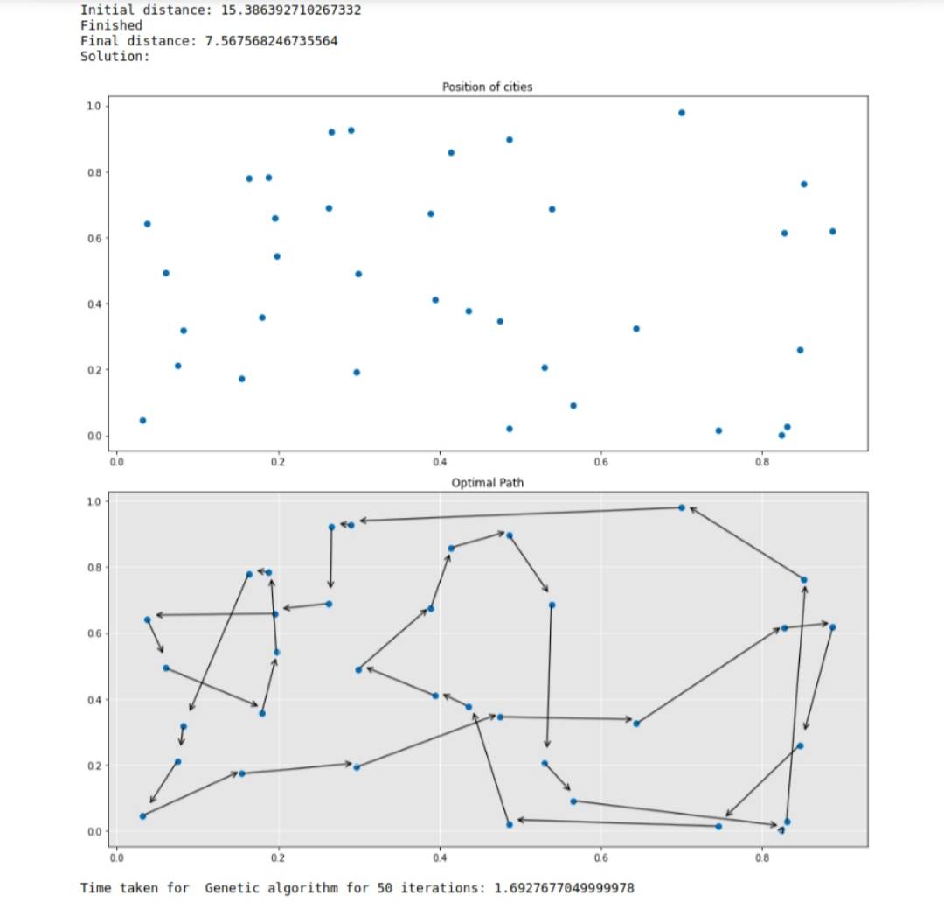
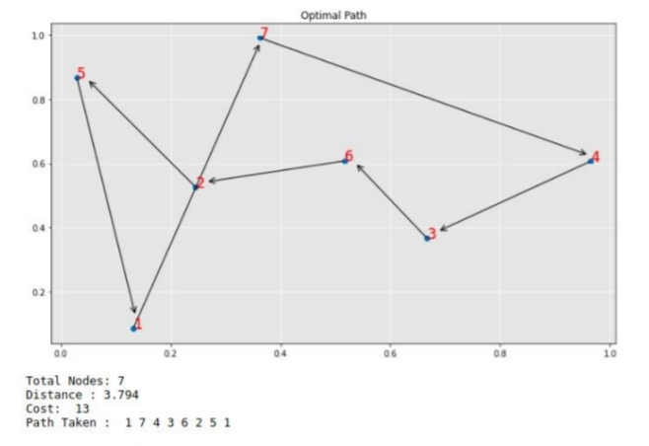
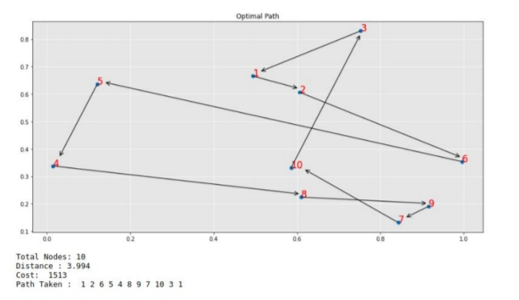
RESULTS

Slide 9
CONCLUSION
This report compares various algorithms used to solve the Traveling Salesman problem. We can conclude that the Genetic algorithm is the fastest while the Naive approach is the slowest among the four algorithms.
Considering the optimal path, dynamic programming approach and naive approach and branch and bound give the shortest path while genetic approach give less favourable paths.

Slide 10

Thank You
Notes:
10

